Slide 1
(IN)complete information, (MIS)Perception, and (UN)Certainty

Slide 2
A Crash course in ir
Int’l system = anarchy
Absence of world gov’t
Anarchy creates commitment and enforcement problems
A self-help system → no gov’t to enforce rules
States must take care of themselves
Security dilemma
We have incomplete information, which creates the possibility of mistakes and deepens uncertainty

Slide 3
Complete information
Def: Absolute and correct knowledge of objective reality
Omniscience
Rational actors would never make mistakes
Irrational does not mean “insane”
Ideal, but impossible
We have incentives to conceal (or misrepresent) info
Notes:
The world is really only interesting in the face of incomplete information. If we knew everything – every possible outcome, every possible cost, every possible benefit, every possible consequence, every possible eventuality – we could not ever make a mistake (it would quite literally be impossible, assuming that we behave rationally).
However, we DO make mistakes, and frequently

Slide 4
Perception
Def: Awareness through the senses
Direct observation of reality
However – perception requires interpretation
Most interpretation happens without evening knowing it
Mistakes and miscalculations
Notes:
Come up with some example to work on perception

Slide 5
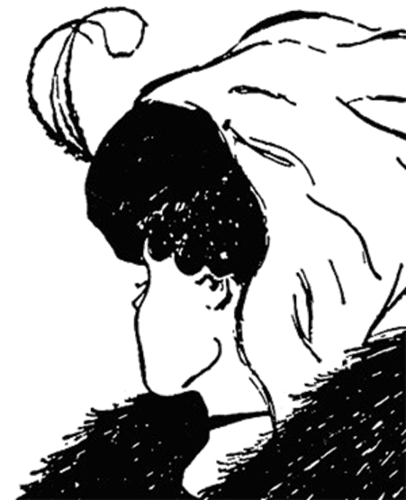

Slide 6
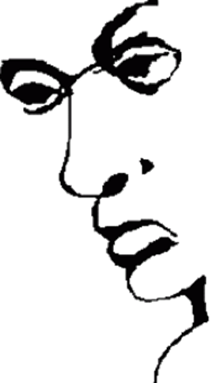

Slide 7
Cognitive biases – subconscious worldviews
We see what we expect to see
Motivated biases – emotional rationalizations
We see what we want to see
Past and personal experience form positive/negative preferences
Notes:
Ask the for their perceptions of someone who orders a soy or almond milk latte at a café. Or who asks for a gluten free menu at a restaurant. Then offer alternative perspectives.

Slide 8
Certainty
Def: The acceptance of fact without doubt
True knowledge
Objective certainty (scientific fact) vs. subjective certainty (belief)
What are we certain of?
How do we know?
Notes:
Here, let’s make a list of things we know, and have them tell you whether it’s objective or subjective certainty. If they say objective, ask the room if anyone in there doubts it.
Do something with color, shape, letters (Greek and Roman in common – alpha, beta, zeta, mu, etc), then more complex stuff.
Ultimately, we can never be 100 percent certain of anything, even that we actually exist.

Slide 9


Slide 10

Notes:
Red-blind protanopia (colorblindness) - how do we know that this isn’t normal vision and those who claim to have normal vision aren’t the ones with visual impairment?
Then do the letter thing.

Slide 11
If we don’t have all the info, misperceive what info we have, and can’t be certain, what do we do?
We can only try to overcome these obstacles
Examine historical relationships
Acknowledge bias
Interpret signals and motivations
Evaluate capability and credibility
Strategic reasoning: costs, benefits, consequences

Slide 12
Historical relationships
Our perception of “others” derives from mutual history
Past conflict → we believe current threats
Past cooperation → we believe current promises
Honesty and bluffing behaviors
Notes:
Let’s think: why are Canada and the US so friendly?

Slide 13
Acknowledge bias
To properly assess reality, we have to be aware of our own perceptions of reality
Recognize biases and preferences and try to understand other side
Then examine why we hold those biases and whether they accurately reflect the info we have

Slide 14
Signals and motivations
To overcome info problems, we send each other signals and try to persuade others of our motives
Must interpret
Some are nothing but “cheap talk” → how do we know if they’re legit?
Tied hands
Sunk costs
Notes:
Action always speaks louder than words

Slide 15
Capability and credibility
Capability – can they do what they say?
Credibility – will they do what they say?
Increased by:
Capability
Reputation for honesty
Value of the issue
Costly signaling

Slide 16
Strategic reasoning
Chess match mentality – think multiple moves ahead
Make contingency plans
Maximize utility – highest payoff at the lowest cost
Realize that both sides are attempting this

Slide 17
